Slide 1
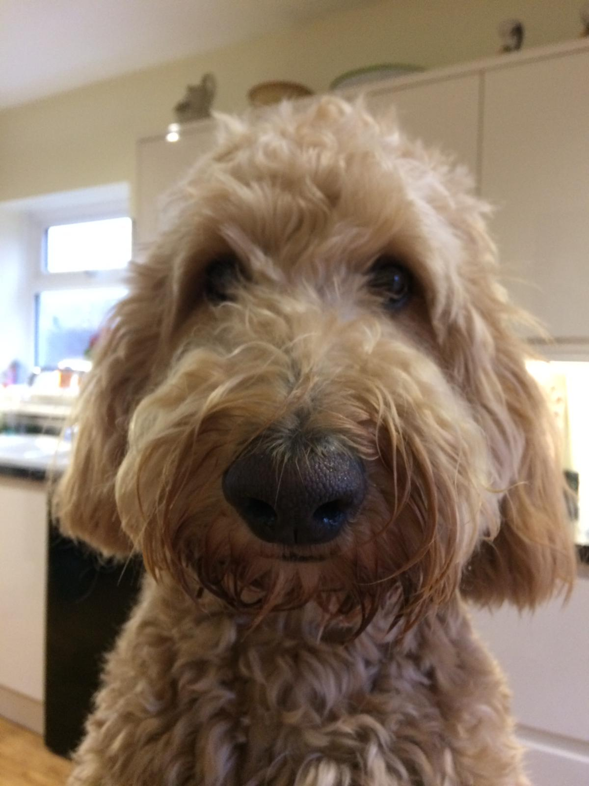

Slide 2
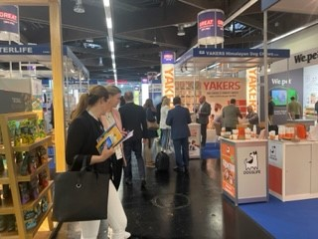
International Pavilions at overseas trade events, showcasing British products

Slide 5
Meet the Buyer

Slide 6
Gordon Thomas PATS Event Director

Slide 7
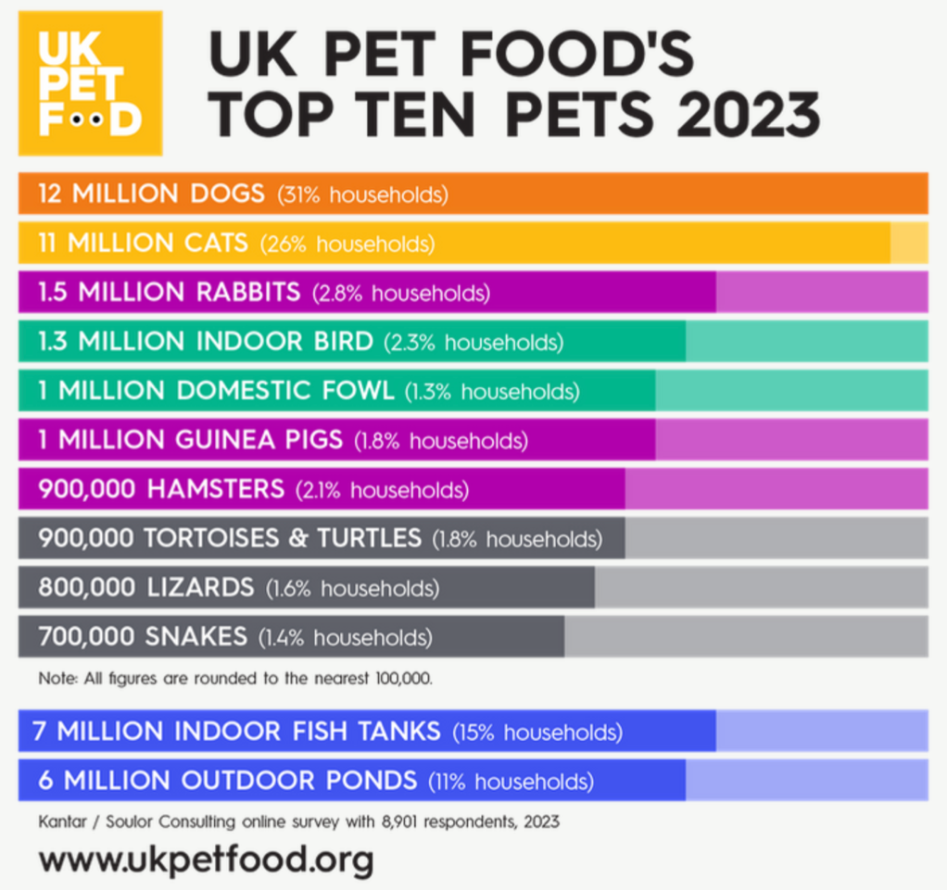
The Importance of the British Market – British People love their pets
57% of British households (16.2 million) now house 38 million pets*
23 million dogs and cats**
50% rise in the number of smaller pets such as rabbits, guinea pigs and hamsters
Companionship, however, is of huge value in times of crisis for mental well-being
* UK Pet Food’s annual pet population data released in March 2023 ** Soulor Consulting online survey 2023

Slide 8
UK Dog Statistics
Estimated number of dogs kept as pets in the UK is 12 million
More than 3 million UK households bought a pandemic pet.
The UK is the second-highest-ranking European country in terms of its dog population, preceded by Germany.
Consumer spending on pet food and pet products and services reached £3.1 billion in 2021.
Veterinary services are the most expensive pet-related expenditures at £2.4 billion in 2021.
Dog owners in the UK spend an average of £594 on dog training services.
Combined pet supplies and services account for over 10% of the average UK salary.

Slide 9
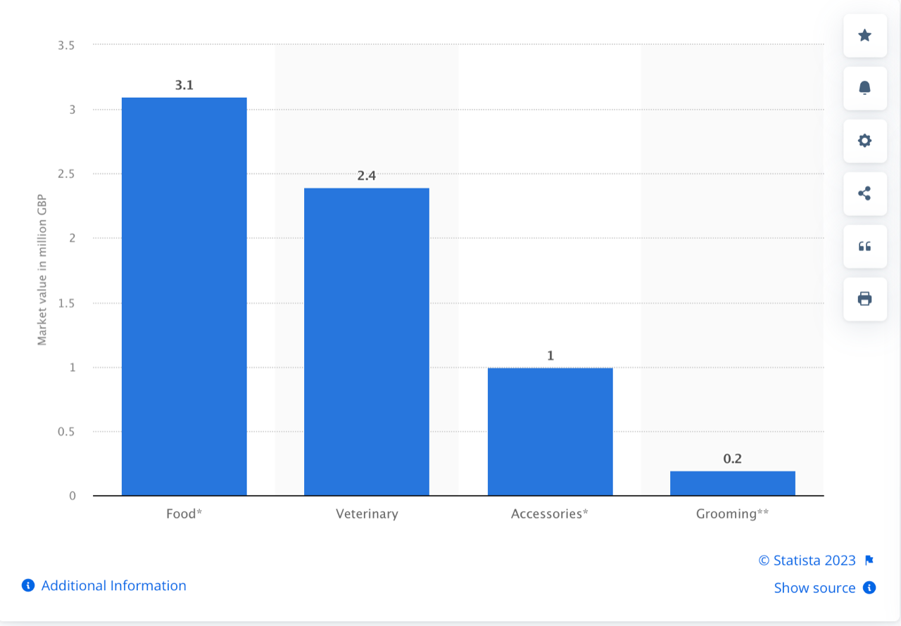
The UK pet industry remains buoyant
Pet Food is the category with the largest market value
Pet Food generated a market value of £3.1 billion in 2021
Veterinary services had a market value of £2.4 billion in that year
Pet Accessories market value of £1 billion
Whole UK pet care market worth £6.7 billion.
figures produced by market and consumer data analysts Statista

Slide 10
UK retail outlets increase
Increase in stores as well as online
UK see’s surge in independents specialising in natural and sustainable products
Garden Centres with dedicated pet departments have aided the growth along with online giants like Amazon
Leading retail groups have increased the number of their stores throughout the country

Slide 11
UK pet industry thrives with innovation
Suppliers and manufacturers, continue to launch innovative products year after year
British Pavilion at Zoomark – shows how diverse and imaginative British companies can be
Companies embrace sustainability and eco initiatives
In addition buyers can visit PATS
PATS provides an ideal opportunity for distributors and large retailers from around the world to see what’s new in the British market.

Slide 12
PATS works closely with PetQuip
Ensures both international visitors and UK suppliers get the most benefit from exhibitions
PetQuip takes a stand at each event and staff assist with overseas enquiries and offer advice
So much to see and do at PATS

Slide 13
Launched in 2009
Aim to provide one event to bring pet trade together
Share knowledge, experience, new ideas
Build great networking and relationships
Industry thrives in face-to-face interaction
Platform to showcase new products
Huge opportunity for visiting retailers to see everything that is new and decide what to stock for the coming season

Slide 15
Centrally Located
Telford International Centre
200 exhibitors taking part
2,185 buyers attended in 2022

Slide 16
200 exhibitors taking part – including key UK players in the Pet Trade

Slide 17
200 exhibitors taking part – including key International players in the Pet Trade

Slide 18
2,185 buyers attended in 2022

Slide 19
What can International visitors expect
Easy access – full range of hotels on site, FREE parking
New Product Showcase – 300 products entered
PATS New Starter Zone – supported by PetQuip, media partner PPM
PetQuip Business Lounge
With over 400 hotel rooms onsite

